Slide 1
Introduction to Git and GitHub
ELI NIMY

Slide 2
Outline
Questions
Why version control?
What is Git?
What is Git Bash?
What is GitHub?
Installing Git and creating a GitHub account
Working with GitHub – Demo and examples

Slide 3
Questions
What do you like about programming?
Where do you store your programming work?
How do you collaborate on programming projects?
How do you share your programming projects?
What do you use to document your coding projects?
Notes:
1. Turning ideas to reality, creating projects

Slide 4
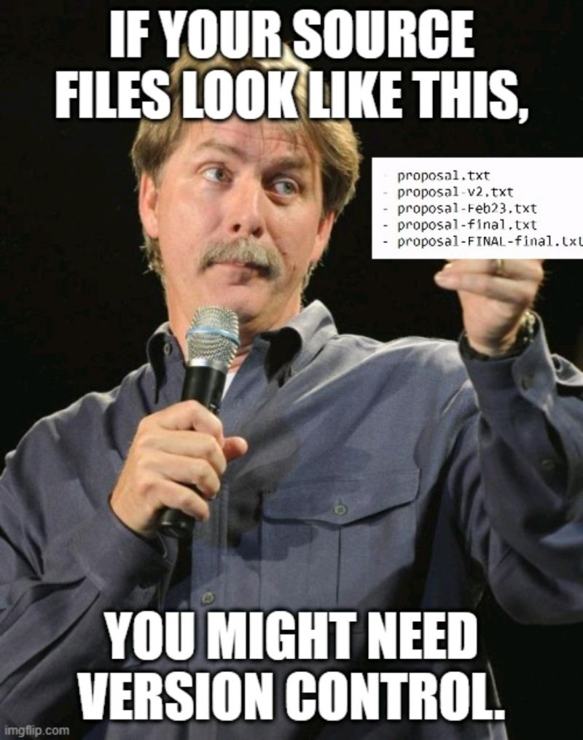
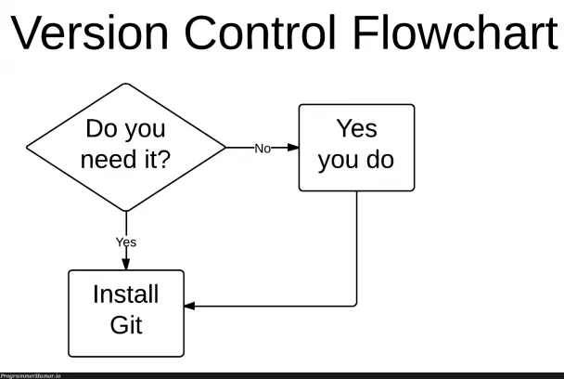
Version Control
Version control: a system that tracks changes in software development, enables collaboration, and provides a history of modifications
Notes:
Challenges addressed
Conflicting code changes
Difficulty tracking changes
Potential loss of data (code)
What if something happens to your PC? Where does the work go

Slide 5
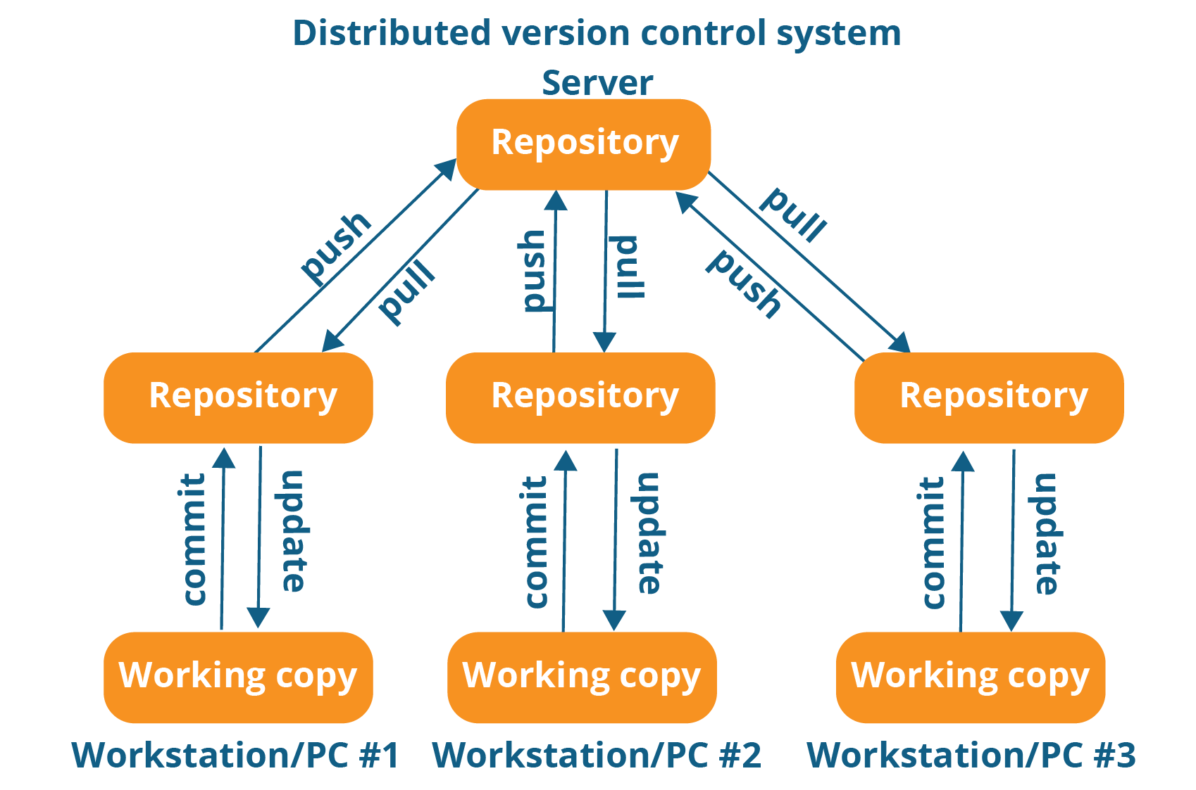
What is Git?
Git: A distributed version control system:
Each user has a complete copy of the repository, including its full history.
Users can work offline and sync changes with others when connected.
Will demo how this works

Slide 6

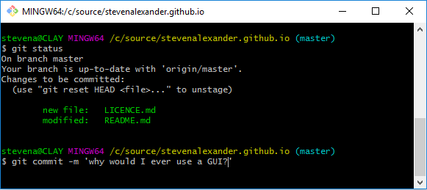
Gitbash – How we interact with Git
Git Bash: A command-line interface for Git on Windows
Uses:
G it operations – interacting with Git
Command-line operations – Unix-like commands: cd, ls, mkdir, cd ..
Integration with other tools – used alongside other tools and utilities in the software development ecosystem.
Notes:
Unix-like - A Unix-style command is a command-line instruction that follows the syntax and conventions commonly found in Unix-based operating systems, such as Linux and macOS. These commands are executed in a terminal or shell, where users can interact with the operating system and software through text-based commands.

Slide 7

What is GitHub
GitHub – A developer platform that allows developers to create, store, manage and share their code.
Uses:
Version control
Code collaboration
Documentation
Sharing code and open source
Community engagement
Portfolio and showcase
Education and learning
Data hosting

Slide 8
Demo 1
Create a public GitHub repository named: random-things
Discuss repository naming conventions
Add a README, licenses, gitignore
Discuss licenses and how to edit the gitignore and README
Copy all the resource files to the repo
Edit repository README
Have a description section
Have git clone section
Add image and link to how to generate image
How to add collaborates
How to delete a repository or edit repository rights
Add a local folder or code to GitHub
How to clone a GitHub repository
How to undo changes or revert back in git
Make changes to files and commit the changes.

Slide 9
Activity 1
Create a public repository
Have a gitignore for all word documents and power points
Document your repository
Add any code or files to your repository that you would like to opensource
You can use the following files if you do not have any files to add: index.html, styles.css and hello_git.py
Share a link to your repository on the chat

Slide 10
Demo 2
Create a repository named: debug-python-functions
Make the repository public
Create a branch for each debug function
The branch should be named after the function being debugged
Write clear commit messages for what was debugged
Merge all changes to the main branch once done
Cover:
How to create branches

Slide 11
Activity 2 – Groups of 3 or 5
Create a repository named: debug-python-functions
Make the repository public
Add collaborators
Each collaborator should debug a function in a separate branch
The branch should be named after the function being debugged
Write clear commit messages for what was debugged
Merge all changes to the main branch once done

Slide 12
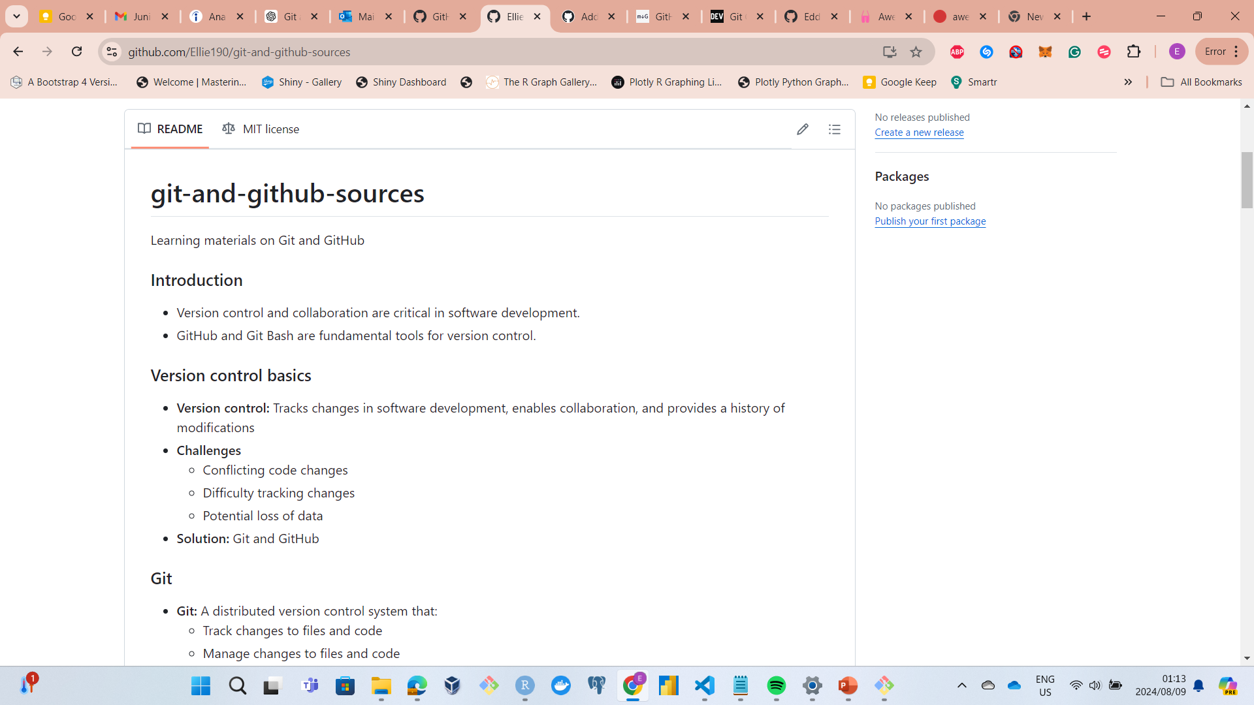
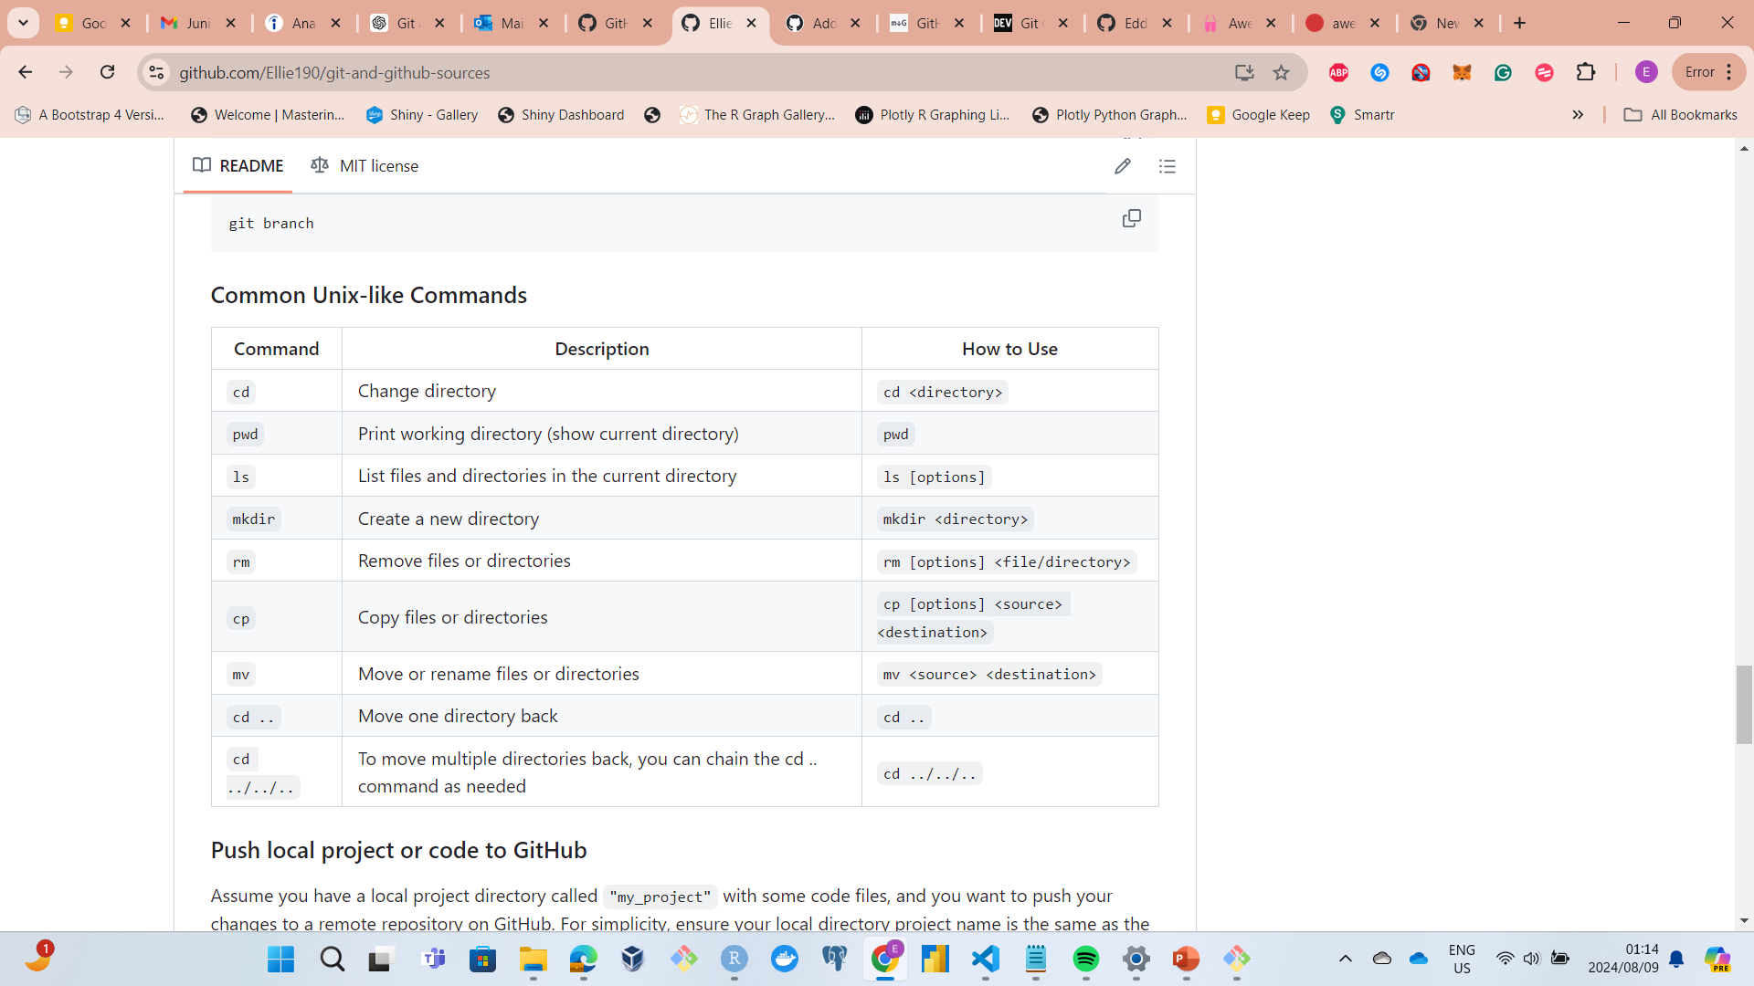
GitHub Use: Documentation
Source link: git-and-github-sources

Slide 13
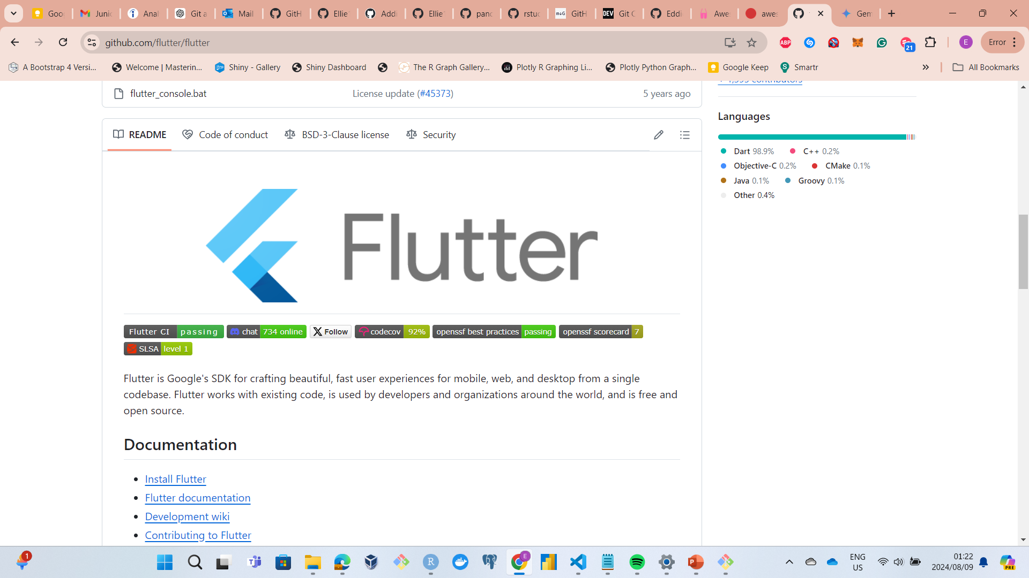

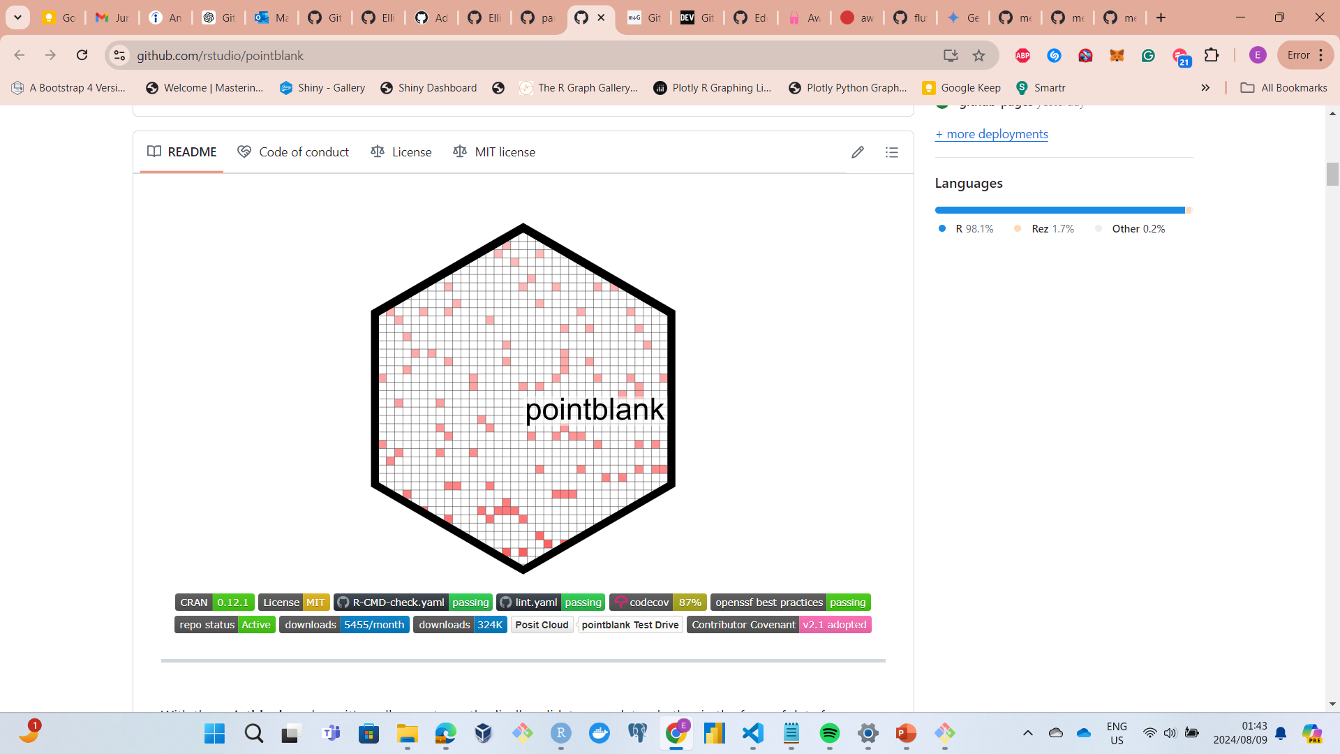
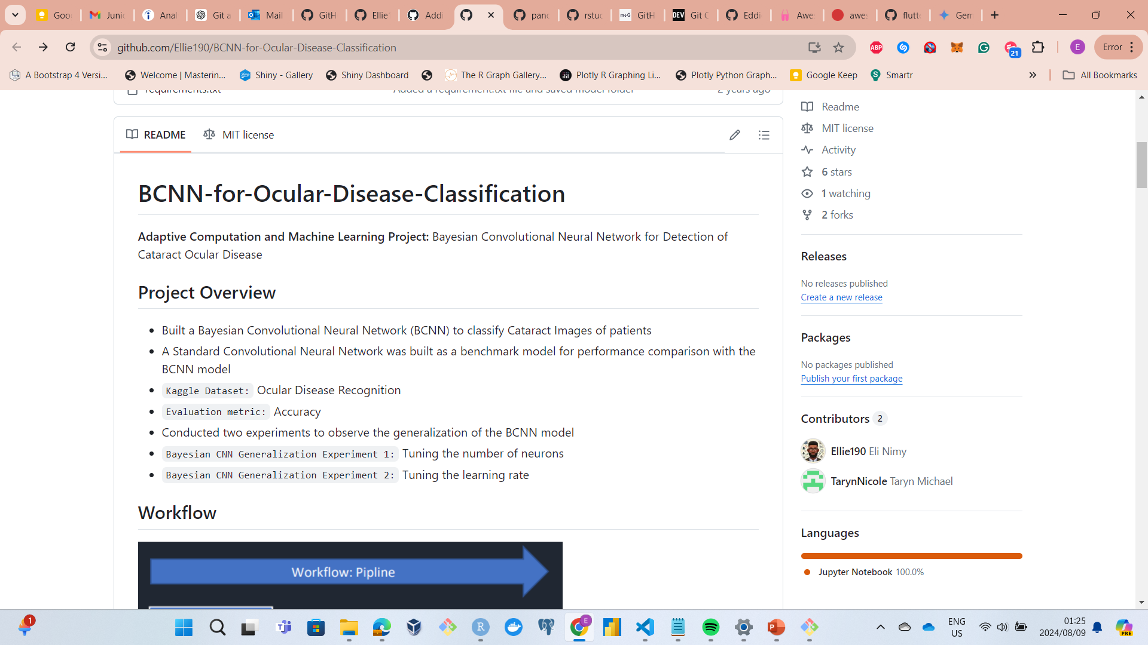
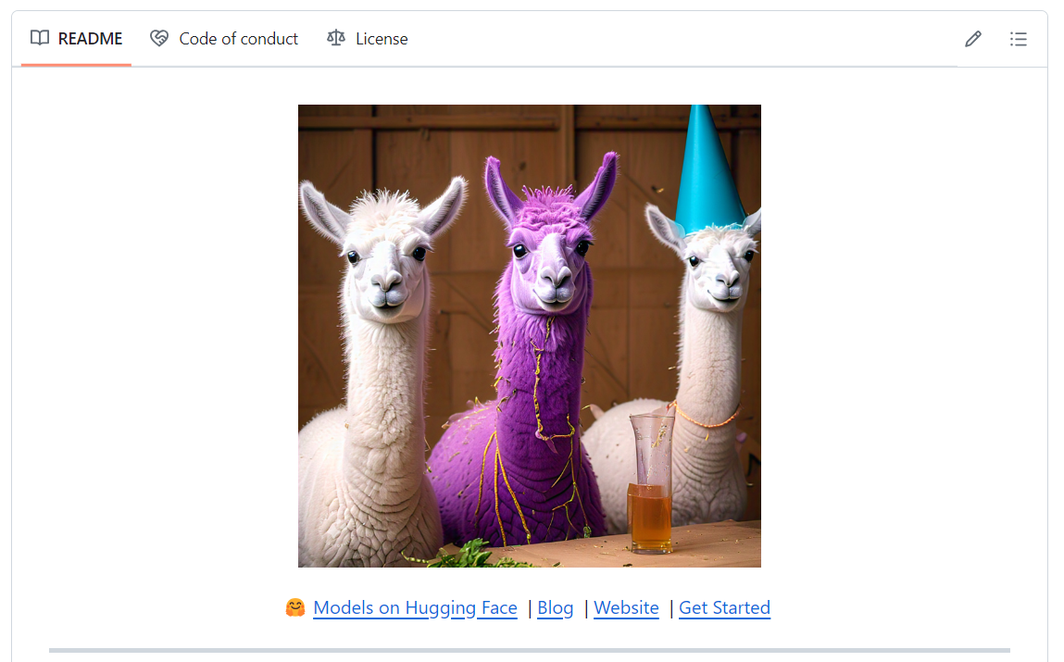
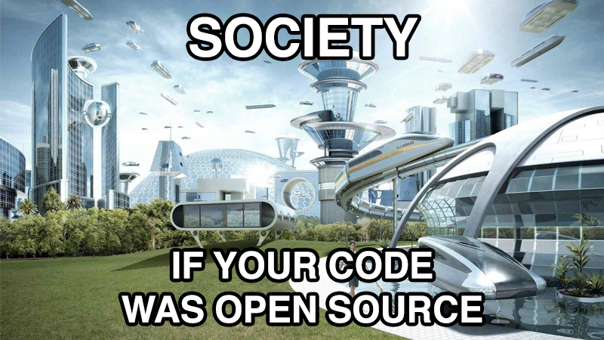
GitHub Use: Sharing Code and Open Source
Flutter
Pandas
Pointblank
BCNN Model
Llma Models
Notes:
You code could be the key to society becoming more advanced. Even if it helps a student advance their HTML or data cleaning

Slide 14
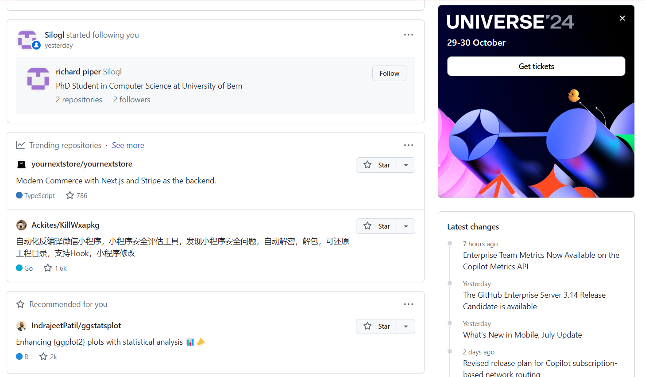
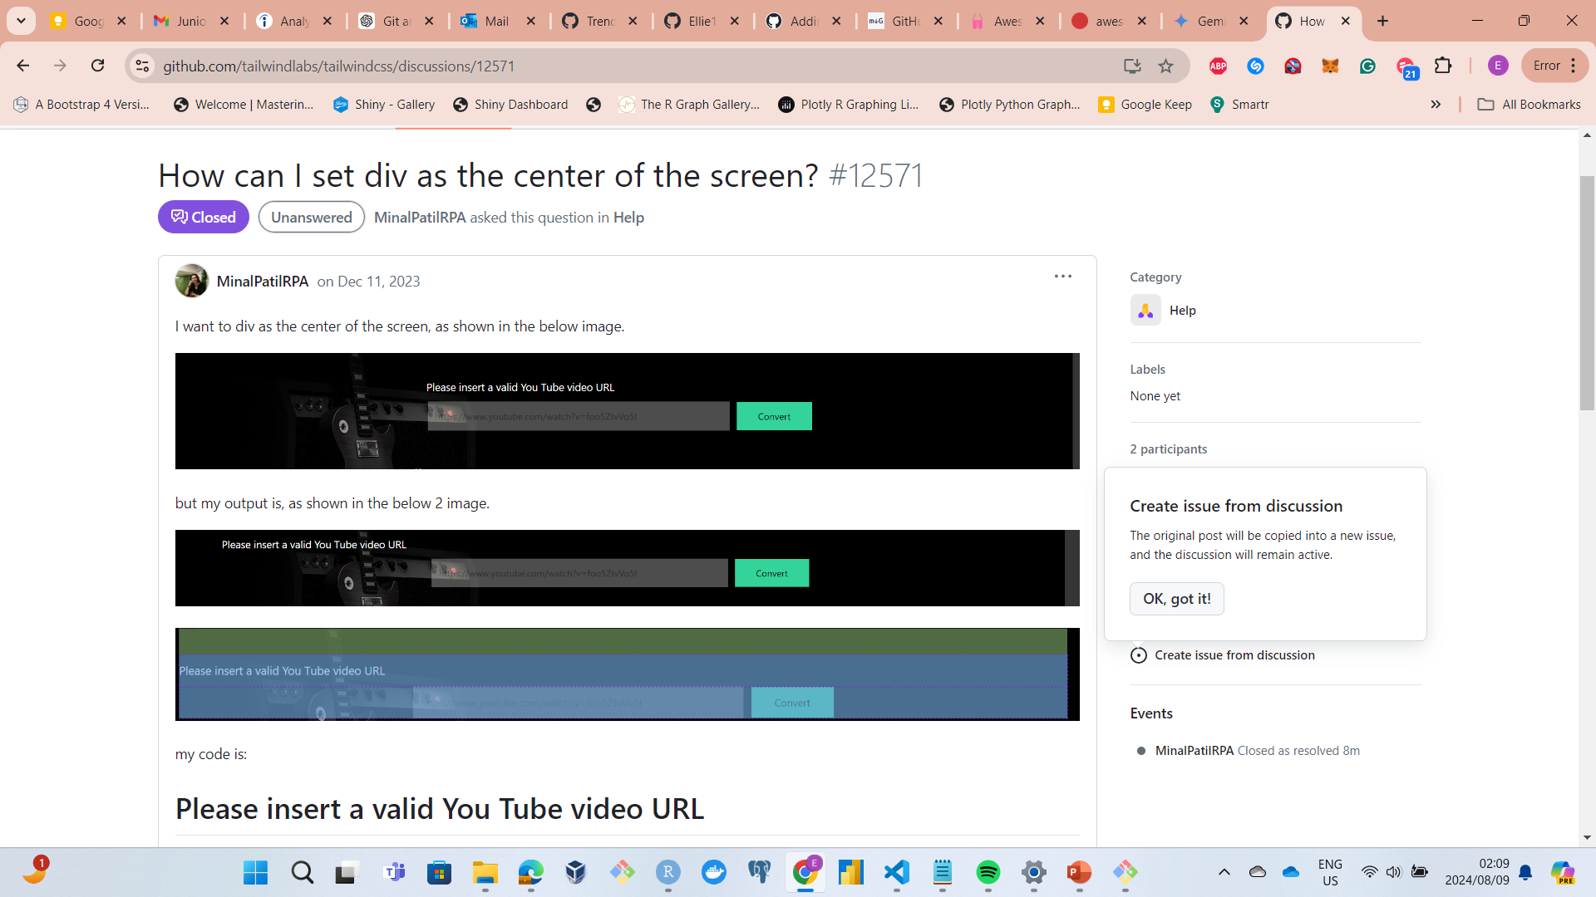
GitHub Use: Community Engagement
Star repositories
Follow people
Raise issues
Contribute to discussions
Etc.
Short discussion example:
https://github.com/

Slide 15
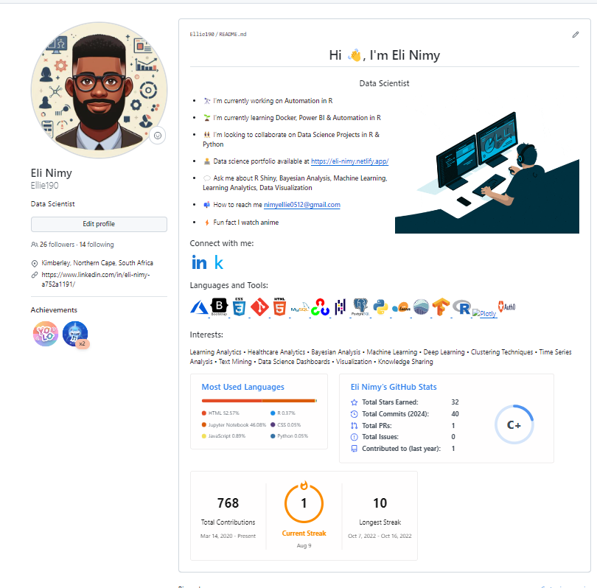
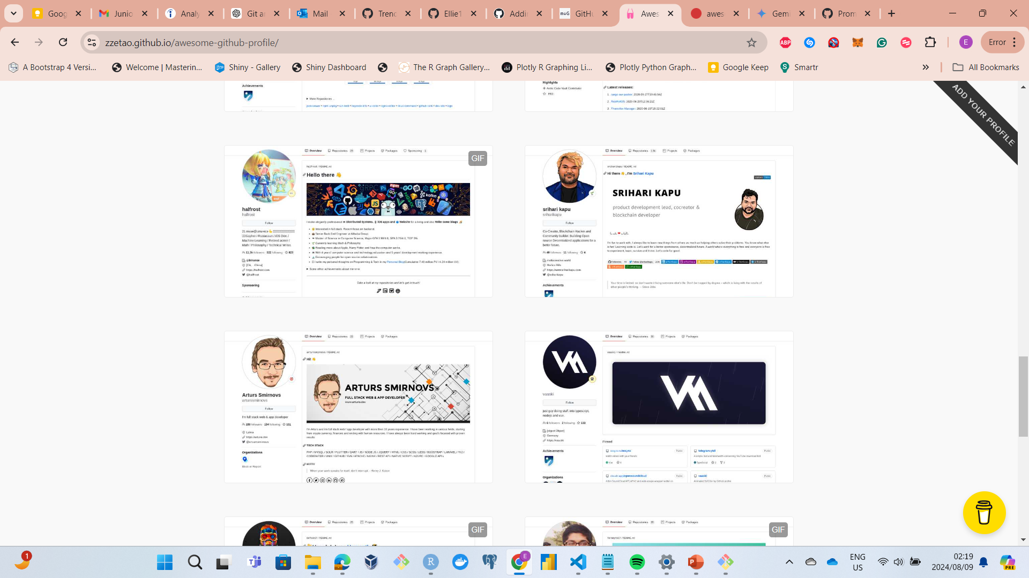
GitHub Use: Portfolio and Showcase
Profile creation
Click New repository
Name your repository as your GitHub account name
Click on Public and Add a README file
Click create repository
Click Edit Read
Navigate to README generator
Edit the README Generator and click Generate
Copy and paste the generated README to your GitHub profile README
Preview and click commit changes
https://github.com/Ellie190
Awesome GitHub Profile READMEs

Slide 16
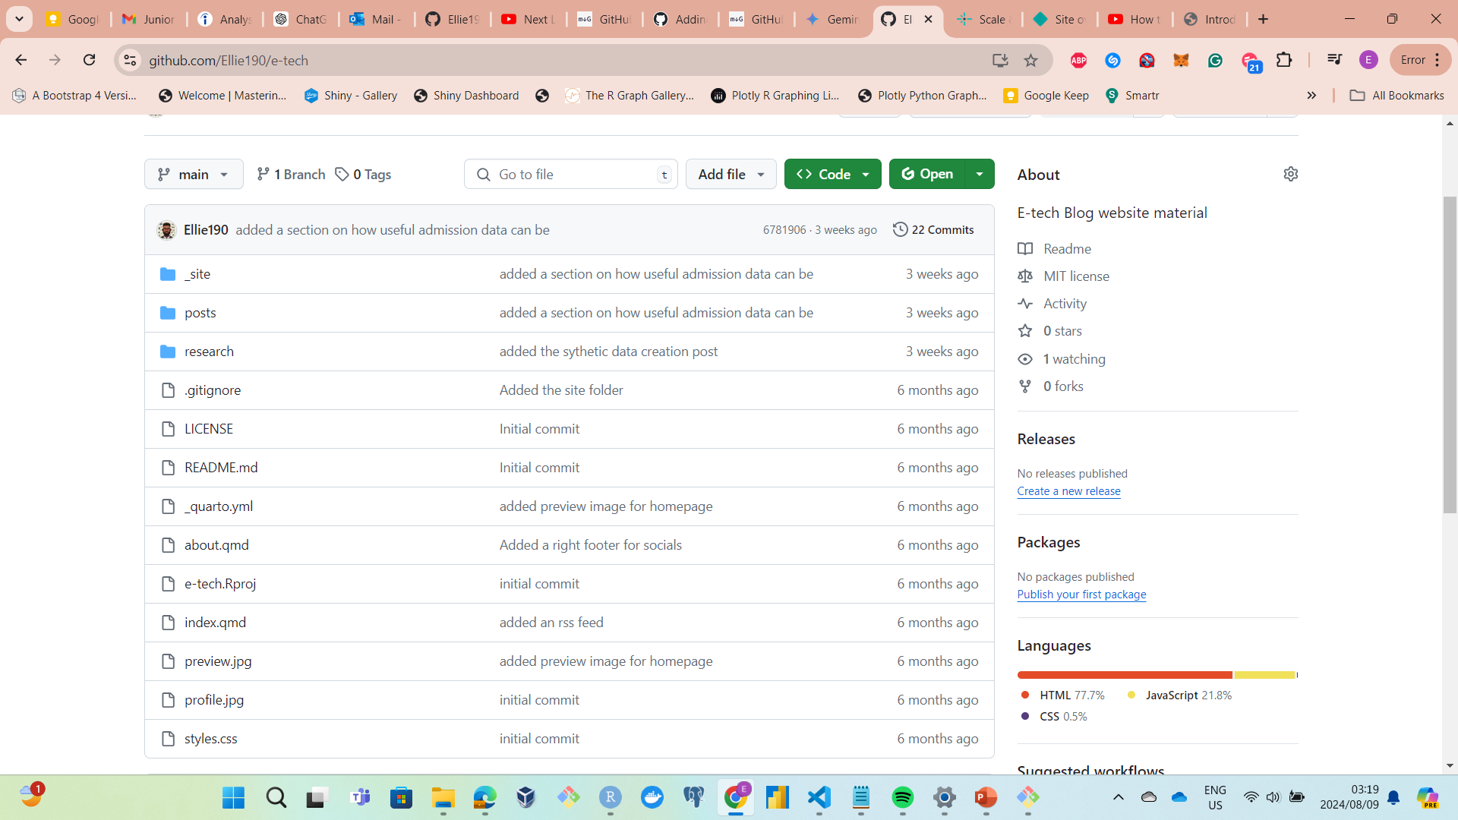
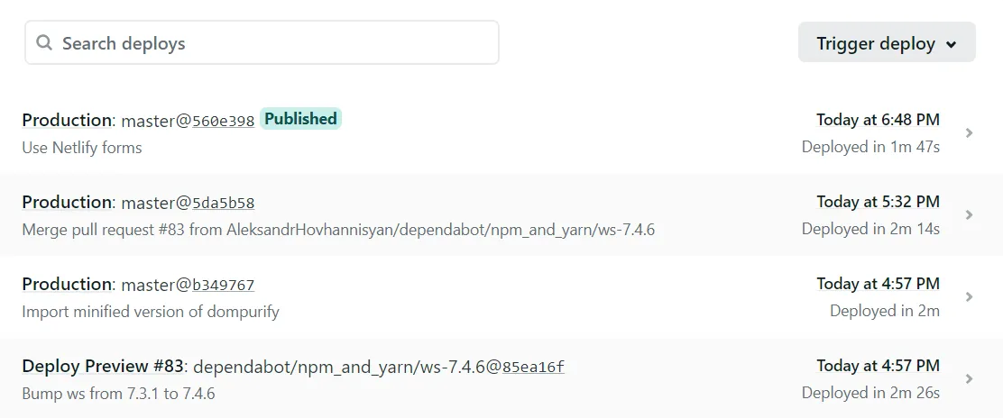
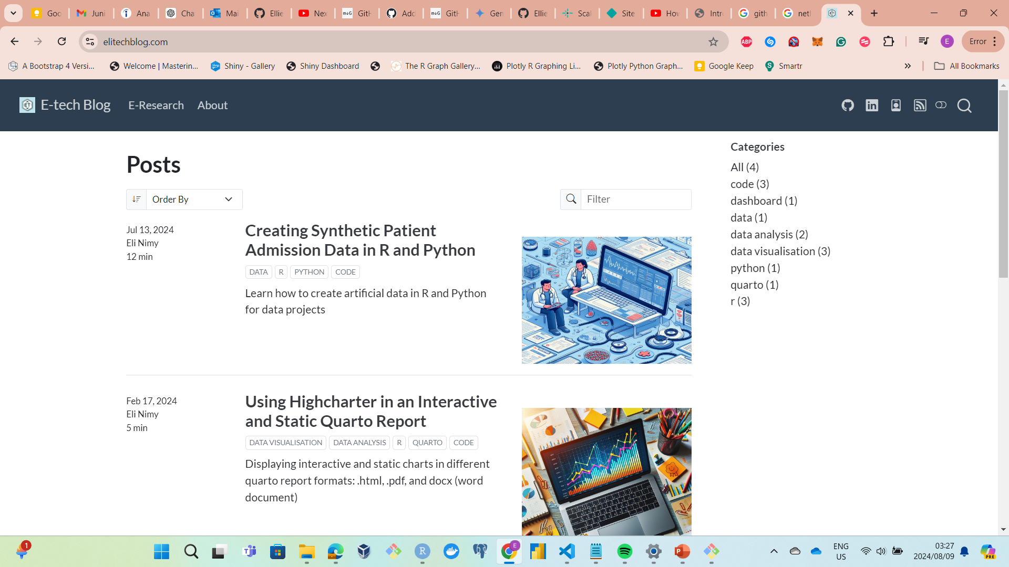


GitHub Use: Data Hosting
Data Hosting: Code, Data, Models, Websites etc.
elitechblog GitHub Repo
elitechblog Website

